Slide 1

CUSTOMER RATING ANALYSIS AND INSIGHTS
* For the Purpose of Forage Virtual work experience program

Slide 2
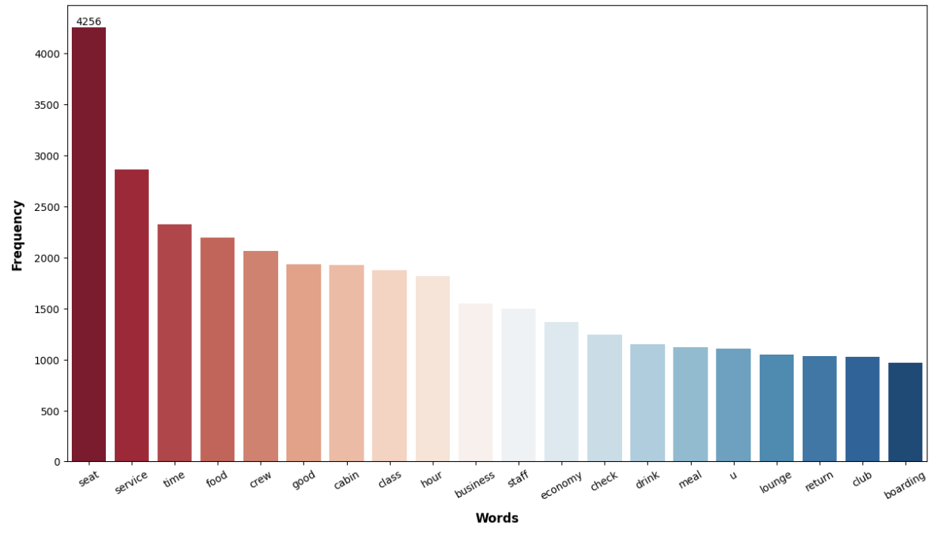
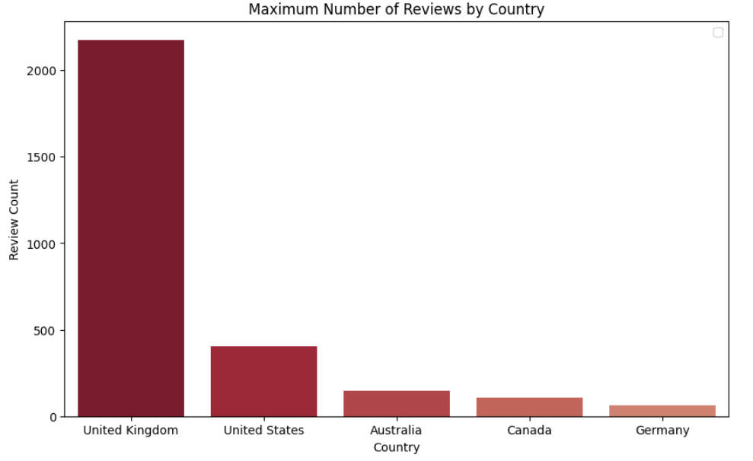
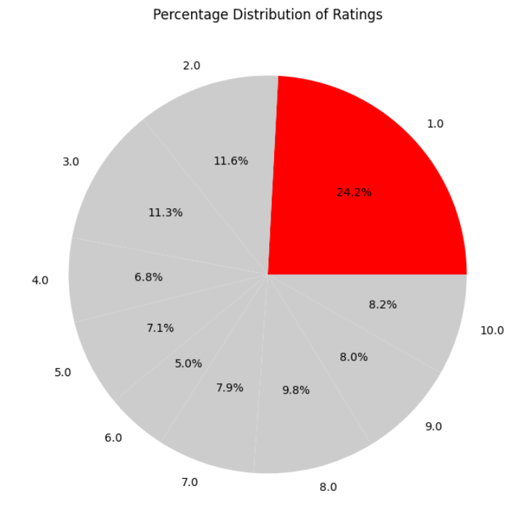
INSIGHTS
Average Overall Rating 4.62/10
3494 Total Reviews
Reviews from 70 Countries
Analysis on Customer Sentiment Across Rating Categories:
High Ratings(7-10): Praises customer service, Comfort for premium economy, Food Quality
Medium Ratings(4-6): Problem with Small entertainment screens, Bad business class services
Low Ratings(1-3): Flight Delays, Cancellations, Luggage Issues,
OVERALL
Customers in general economy liked cabin crew services, food
Many reviews from business class
Focus on improving the business class experience, Work on flight delays, cancellations, and Luggage issues.

